Slide 1

A STUDY ON APPLICATIONS OF GRAPH THEORY IN SOCIAL NETWORK ANALYSIS
By
Felix t
22pmaa011
II M.sc mathemaTICS

Slide 2
UNDER THE GUIDANCE OF
Mr. A. bhaalamurugan M.Sc.,M.Phil.,B.Ed
ASSISTANT PROFESSOR
DEPARTMENT OF MATHEMATICS

Slide 3
CONTENTS
Graph definitions
Types of graphs
Matrix representations
NETWORK overview
Representation of network as graphs
Types of networks
Characteristics involved In networks
Measures and metrics used
Centrality measures

Slide 4
INTRODUCTION
Networks are systems of interconnected elements which can be found in various domains such as social networks, transportation systems, and biological networks.
They are comprised of nodes (vertices) and edges (links) that connect these nodes. Nodes represent individual entities, while edges denote relationships or interactions between them.
Mathematical graph theory provides a powerful framework for modeling and analyzing the complex interactions within social networks..
Centrality in the context of graph theory and network analysis refers to the measure of importance or prominence of a node within a network. It quantifies the significance of a node based on its position and connections within the network.

Slide 5
CHAPTER 1 MATHEMATICAL FUNDEMETALS
Vertices
The vertex is the point at which two rays (edges) of an angle or two edges of a polygon meet.
Edges
An edge is a line at which vertices are connected in the graph. Edges are denoted by E=(U,V) it is a pair of two vertices.
MULTI GRAPH
If more than one line joining two vertices are allowed then the resulting object is called a multi graph. Lines joining the same points are called multiple lines.

Slide 6
MULTI GRAPHS
If more than one line joining two vertices are allowed then the resulting object is called a multi graph. Lines joining the same points are called multiple lines
PSEUDO GRAPHS
If an graph contains multiple lines and loops then it is called a pseudo graph.
COMPLETE GRAPHS
A graph in which any two distinct points are adjacent is called a complete graph.
A complete graph with p vertices is denoted by K_{p}.
BIPARTITE GRAPH
A graph G is called a bigraph or bipartite graph if the vertex set V can be partitioned into two disjoint subsets V₁ and V₂ such that every line of G joins a point of V­₁ to a point of V₂. (V₁, V₂) is called a bipartition of G.

Slide 7
PROPERTIES OF A GRAPH
DEGREE
The degree of a vertex v of G is the number of edges incident with v, and is denoted by deg(v).
WALK
A Walk in a network is a sequence of nodes from the network such that every consecutive node pair in a sequence is adjacent. A Walk can pass through the same node or edge more than once.
TRIAL
A trail in a network is a walk with no repeated edges.
PATH
A path in a network is an open trail with no node repeated (or) it is a walk with distinct nodes and edges.
CYCLE
A cycle in a network is a closed path.

Slide 8


Chapter 2 Algebraic graph theory
ADJACENCY MATRIX
A network G (V , E) is generally represented or stored using a adjacency matrix A ∈ R^(|V|×|V|), a square matrix whose each element a_{ij} indicates an existence of an edge between node i and j.
The adjacency matrix of an undirected and unweighted network is a symmetric matrix with zeros on its diagonal.
An entry aij in the adjacency matrix of a directed network indicates an existence of an edge from node i to node j.
X_{ij} = 1, if there is an edge between i-th and j-th vertices, and
X_{ij} = 0, if there is no edge between them.
INCIDENCE MATRIX
Let G = (V, E) be a graph with V = {v₁, . . . , v_{n}} and E = {e­₁, . . . , e_{m}}.
Then the incidence matrix B = B(G) of G is the n × m matrix defined by
b_{ij} =$\left\{\begin{aligned}1 if v_{i} ∈ e_{j} \\ 0 otherwise\end{aligned}\right.$

Slide 9

SPECTRUM OF A GRAPH
The set of eigenvalues of a graph G is known as the spectrum of G and denoted by ${ S}_{P}\left(G\right).$
Let G be a graph of order n with vertex set V={ $v_{1},…..,v_{n}\}$. The adjacency matrix of G (with respect to this labelling of V) is the n by n matrix A=$a_{ij}$, where
$a_{ij=}$ $\left\{\begin{aligned}1 if v_{i} is adjacent to v_{j} in G \\ 0 otherwise \end{aligned}\right.$
Thus A is the real symmetric matrix of order n. Hence,
i)The Spectrum of A that is the set of its eigen values is real
ii)R^{n} has an orthonormal basis of eigen vectors of A.
iii)The sum of the entries of the i-th row (column) of A is d$\left(v_{i}\right) in G$.
The Spectrum of A is called the spectrum of G and denoted by S_{p}(G).

Slide 10

CIRCULANT MATRIX
A Circulant matrix of order n is a square matrix of order n in which all the rows are obtained by successive cyclic shifts of one of its rows (usually taken as the first row)
For example, the circulant with first row (a₁ a₂ a₃) is the matrix $\left(\begin{matrix}\begin{matrix}a_{1} \\ a_{3}\end{matrix} & \begin{matrix}\begin{matrix}a_{2} & a_{3}\end{matrix} \\ \begin{matrix}a_{1} & a_{2}\end{matrix}\end{matrix} \\ a_{2} & \begin{matrix}a_{3} & a_{1 }\end{matrix}\end{matrix}\right)$
The eigenvalues and eigenvectors of a circulant matrix have special properties and can be expressed in terms of discrete Fourier transforms.
Circulant matrices allow for efficient matrix-vector multiplication, which is useful in various applications, such as signal processing and linear system solving.

Slide 11
CHAPTER 3 OVERVIEW OF NETWORK ANALYSIS
Social network analysis (SNA) is a methodological approach that examines social structures through the lens of networks.
It involves the study of relationships and interactions among individuals, groups, or entities.
Networks are represented by nodes and ties, providing a visual and mathematical framework for understanding social structures.
The need for a social network and the methods of social network analysis is that it mainly focuses on relationships among social entities, and on the patterns and implications of these relationships.
The social network perspective encompasses theories, models, and applications that are expressed in terms of relational concepts or processes.

Slide 12
Importance of social network analysis
Social network analysis helps pinpoint influential individuals within a network, enabling targeted engagement and strategic influence.
It provides insights into how information spreads within a network, facilitating the design of effective communication strategies.
Social network analysis aids in identifying and understanding communities or groups within a network, fostering targeted interventions and community-based approaches.
By analyzing network connections, it can predict trends, behaviors, and adoption patterns, assisting in proactive decision-making.
Social network analysis guides the efficient allocation of resources by revealing key connections and dependencies within a network structure.
It fosters improved collaboration and teamwork by visualizing and optimizing communication patterns and relationships within an organization.

Slide 13
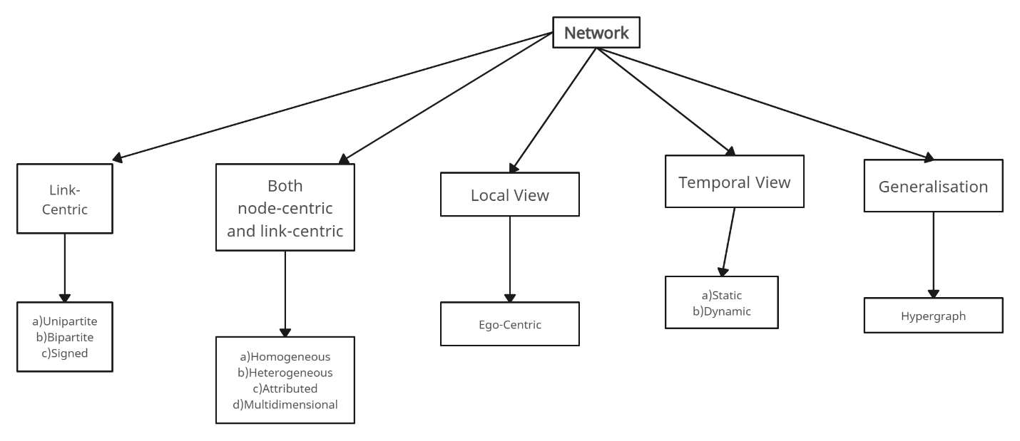
TYPES OF NETWORKS

Slide 14
CHAPTER 4 MEASURES INVOLVED
Centrality
Centrality refers to the measure of importance or significance of one node within a network. It quantifies significance of a node based on its position and connections within the network. Nodes with higher centrality are considered more influential or central to the structure and dynamics of the network.
Types of centrality used:
i)Degree centrality
ii)Closeness centrality
iii)Betweenness centrality
iv)Eigenvector centrality

Slide 15
APPLICATIONS OF CENTRALITY MEASURES
In online social networks such as twitter or facebook, Degree centrality is often used to identify the most influential users. This is particularly useful for marketing wherein the detected influential user can promote a product to his/her followers.
Closeness centrality is used to examine the extent of information spread in the network. It is used to analyze the spread of fake news misinformation on twitter or facebook, etc. It is also used in epidemic modelling wherein the spread of a particular disease is examined on a patient network.
C)Betweenness centrality is useful in analyzing disease spreading in epidemiology, where super spreaders are identified as nodes with higher betweenness centrality. In security networks, it is used as an indicator to spot suspected spies.
D)Eigenvector centrality is used to find the most significant nodes in a network. It can be used as a metric to show that a person’s choice influences an efficient social outcome.

Slide 16
CONCLUSION
Social network analysis is a powerful tool for unravelling complex relationships and dynamics within networks, providing valuable insights into human interactions.
Through the examination of network structures, social network analysis contributes to a deeper understanding of social phenomena, facilitating targeted interventions and informed decision-making.
Its applications span diverse fields, from marketing and public health to organizational management, highlighting its versatility and significance in addressing real-world challenges.
social network analysis stands as a crucial methodology for comprehending the intricacies of social connections, offering practical applications for fostering collaboration, predicting trends, and driving positive societal outcomes.

Slide 17

REFERENCES
Barnes, J.A. 1983. "Graph theory in network analysis" Social Networks 5: 235-244.
Berkowitz, S.D. 1982. An introduction to structural analysis: The network approach to social research Toronto: Butterworths
Baker, Wayne E. 1990. "Market Networks and Corporate Behavior" American Journal of Sociology. 96: 589-625.
Newman, M. E. J. (2010). Networks: An Introduction. Oxford University Press.
Jackson, M. O. (2008). Social and Economic Networks. Princeton University Press.

Slide 18

THANK YOU

